Slide 1
Web Technology
Part 7:
JavaScript Language – p.5
AngularJS – 2
JS LINQ

Slide 2
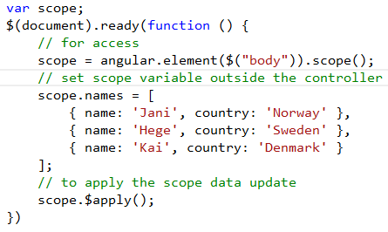

Angular - Using with JQuery
Accessing scope variables and methods from HTML elements
Accessing HTML elements from controller
with_jquery.htm

Slide 3
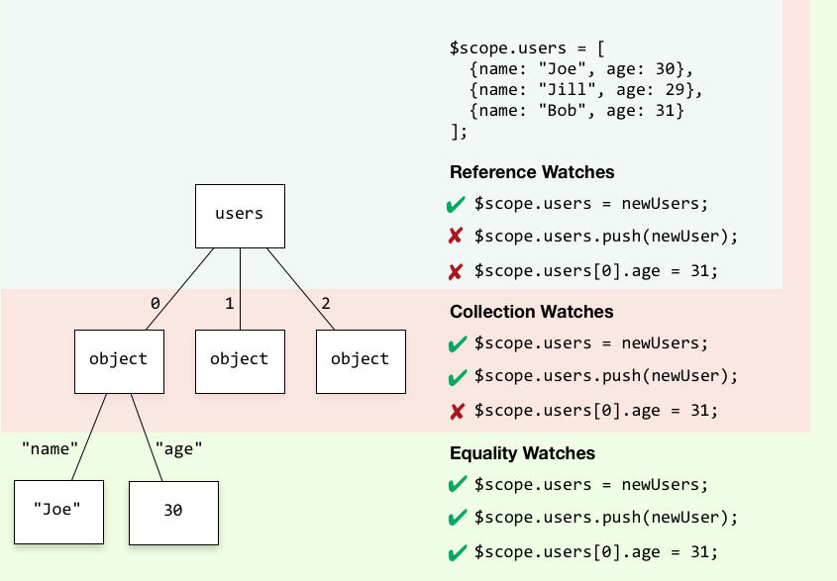
Angular - Tracking changes
watches.htm

Slide 4
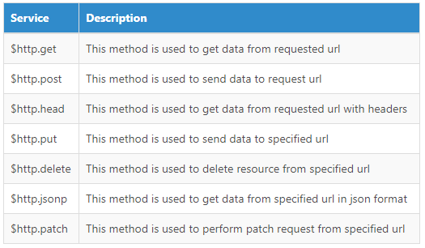
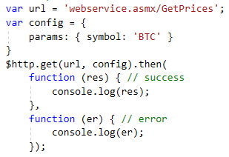
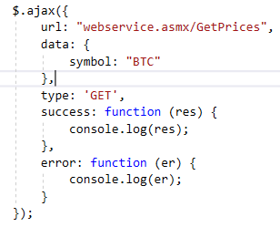
AngularJS vs JQuery - AJAX
AngularJS
AngularJS $http Service Methods
JQuery

Slide 5
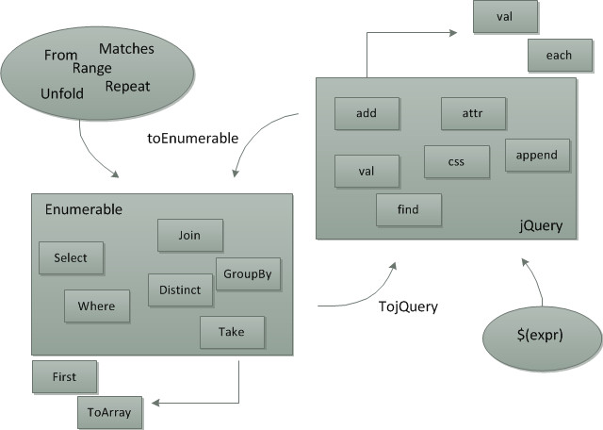
JS LINQ - introduction
linq.js - LINQ for JavaScript
linq.js Reference & LINQPad

Slide 6
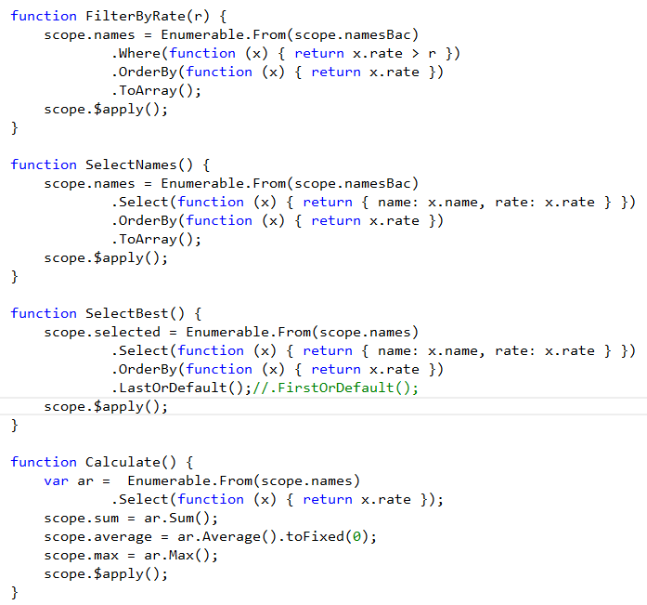
JS LINQ – main methods
Average, Count, Sum,
Contains,
First, FirstOrDefault,
GroupBy,
IndexOf,
Last, LastIndexOf, LastOrDefault,
Max, MaxBy, Min, MinBy,
OrderBy, OrderByDescending, ThenBy, ThenByDescending,
Range,
Select,
ToArray,ToJSON, ToObject, ToString
linq.htm

Slide 7
Exercises
Analysis of the tasks from Lab 6
Students data management application (LINQ and angular)

